Slide 1

Embedded Snake
Jonathon Moore
SWE-350

Slide 2
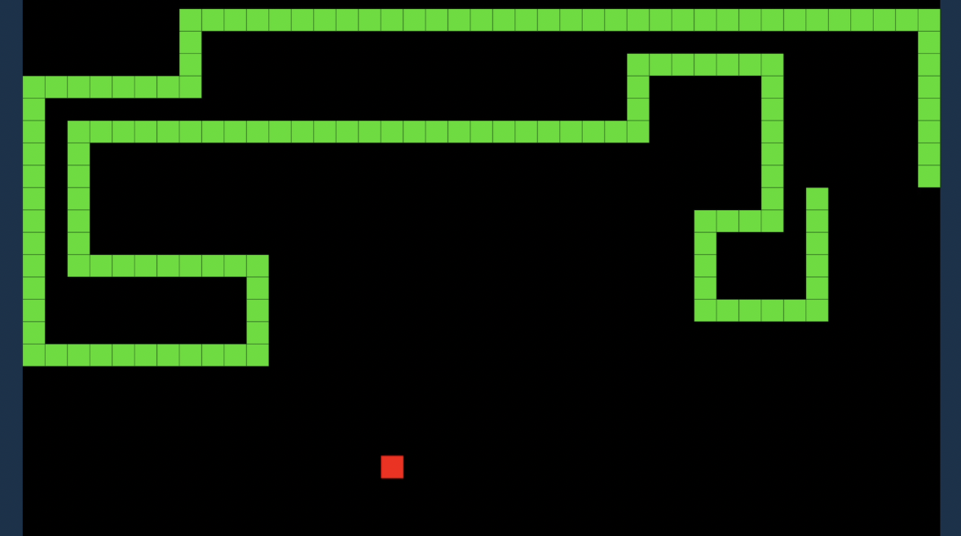
Project Overview
Game of Snake
Runs on Intel DE10-Standard
Utilizes Linux OS
Written in C
Integrates FPGA
Displays to LCD and LED
Takes input from buttons
Introduction to embedded systems

Slide 3
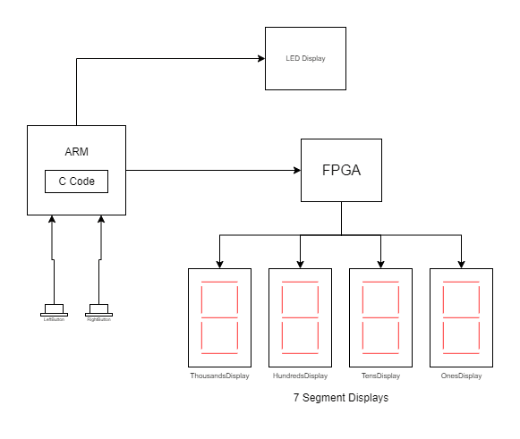
System Design

Slide 4
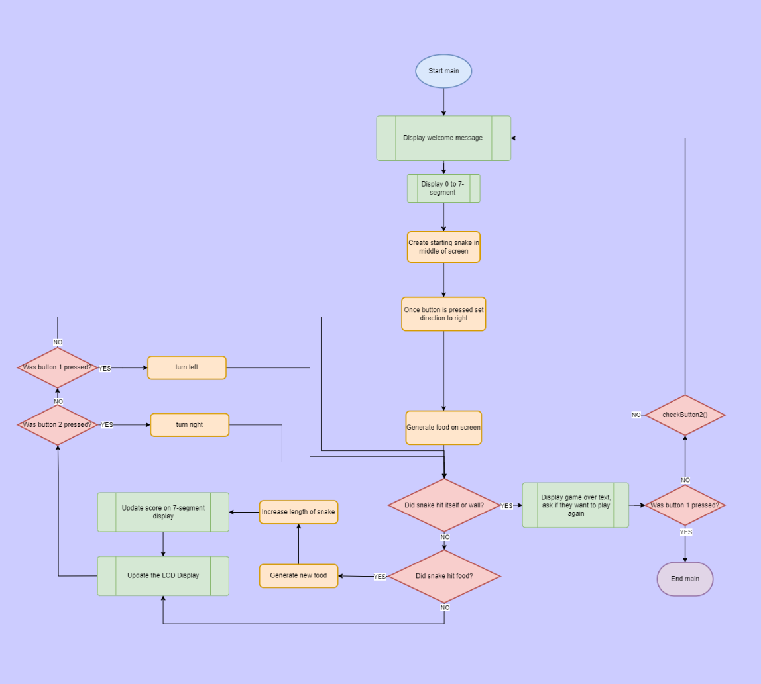
Application Design

Slide 5
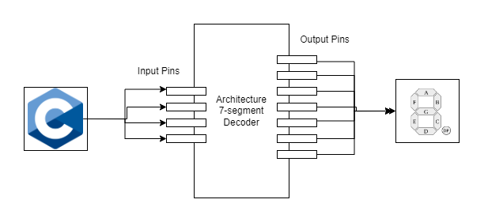
VLSI Design

Slide 6

Functionality
User can see the game on LCD
User can press button 1 to turn right or button 2 to turn left
User can see their current score on LED Display
If the user hits a wall or themselves they will die
User can replay if they die
Snake will get longer each successful eating

Slide 7
How was it designed?
Issues
Figure out how to track the array for snake positions
Map the snake positions to pixel positions for display
Encapsulate all the hardware functionality into its own class
Game loop
Future
Implement a high score with text file
Maybe move to an external display

Slide 8
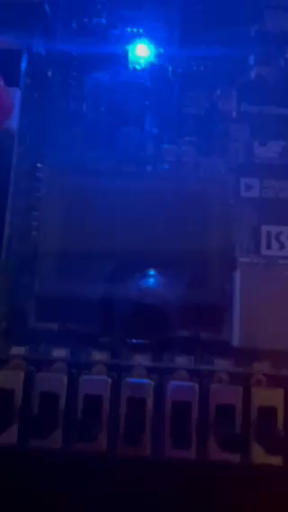
Video

